Slide 1
Differentiation of species
Examining natural selection’s effect on the genetic diversity

Slide 2
Presentation Layout
Biological background
Step 1: Genetic and physical distance
Step 2: Environment

Slide 3
Biological background

Slide 4
Step 1: Genetic and physical distance

Slide 5
Random walking on a grid

Slide 6
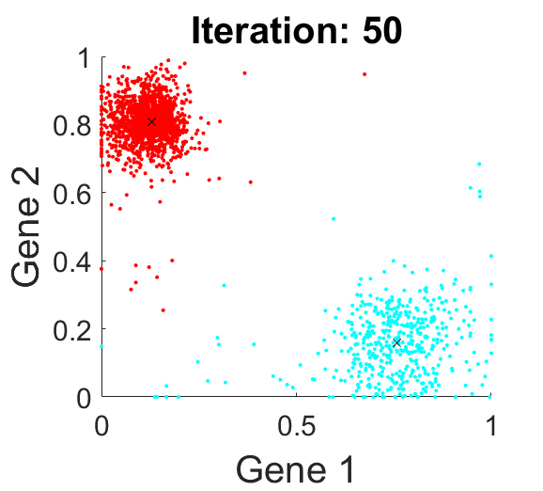
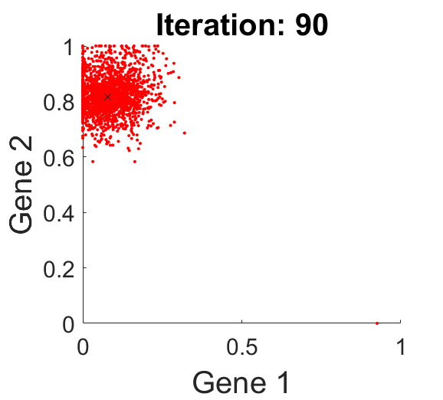
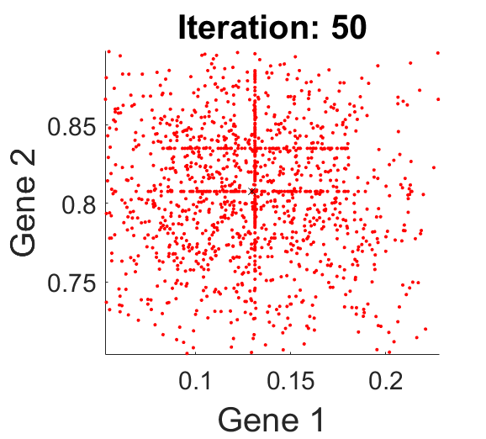
Graph of gene space

Slide 7
Step 2: Environment

Slide 8
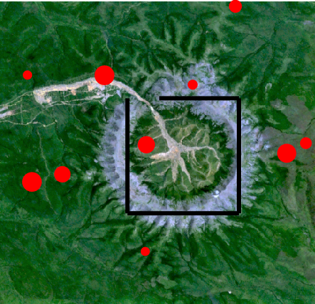
Environment
Black lines are boundaries for mountains
Red dots are food sources
Larger dot = more food

Slide 9
The genes
Less food
More food
Size
“Height”
Small
Large
I
0
1
G
G-ε
G+ε
Fast
Slow

Slide 10
Conclusion

